Slide 1
人工智能原理
第3章 启发式搜索

Slide 2
复习

Slide 3
复习-盲目搜索
Breadth-first： depth(n)
Uniform-cost: g(n)
Depth-first: -depth(n)
Depth-limited: -depth(n), depth(n)<=limit
Iterative deepening
Speeding up techniques
Avoiding repetitive states
Bi-directional search (自学)
Blind strategies do not know which node in frontier is closer to the goal.

Slide 4
启发式搜索（有信息搜索）
1 启发式函数：如何更快地接近目标？ 什么是启发式函数？什么是启发式搜索？
2 贪婪最佳优先搜索，A*搜索
3 可采纳性、一致性、准确性、松弛问题：什么是可采纳的启发函数？什么 是一致的启发函数? 启发式函数的准确性。如何设计可采纳的启发函数？

Slide 5
Part 1
启发式函数-Heuristic functions
启发式搜索-Heuristic Search: Search with heuristic functions
最好优先（贪心）搜索-Best first (greedy) search

Slide 6
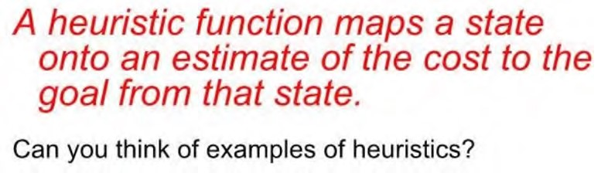
Heuristic functions
We can encode each notion of the “merit” of a state into a heuristic function, h(n).
Heuristics are sensitive to the problem domain.
Heuristic for planning a path through a maze?
Heuristic for solving a Rubick’s cube?

Slide 7
Search with Heuristic Functions
If h(n₁) < h(n₂) this means that we guess that it is cheaper to get to the goal from n₁ than from n₂.
We require the follows:
h(n) = 0 for every node n whose terminal state satisfies the goal.
Zero cost of achieving the goal from node that already satisfies the goal.
Notes:
Heuristic function: h(n1), h(n2) 如果h(n1)具有比h(n2)小的值，表示我们猜测从n1到达目标的花费更低。

Slide 8
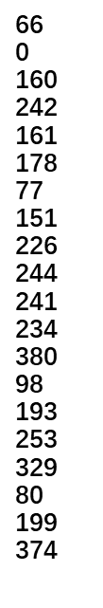
Euclidean distance as h(s)
h(x)
Oradea
Straight−line distance
71
to Bucharest
Neamt
Arad
87
Bucharest
75
Zerind
151
Craiova
Iasi
Dobreta
Arad
140
Eforie
92
Fagaras
Sibiu
99
Fagaras
Giurgiu
118
Vaslui
Hirsova
80
Iasi
Timisoara
Rimnicu Vilcea
Lugoj
142
Mehadia
111
97
Pitesti
211
Neamt
Lugoj
Oradea
70
98
Pitesti
146
101
85
Hirsova
Rimnicu Vilcea
Mehadia
Urziceni
Sibiu
75
138
86
120
Bucharest
Timisoara
Dobreta
90
Urziceni
Craiova
Eforie
Vaslui
Giurgiu
Zerind
Say we want to plan a path from Arad to Bucharest, and we know the straight line distance from each city to our goal. This lets us plan our trip by picking cities at each time point that minimize the distance to our goal (or maximize our heuristic).

Slide 9
Arad
366

Slide 10
Arad
Sibiu
Timisoara
Zerind
253
329
374

Slide 11
Arad
Sibiu
Timisoara
Zerind
329
374
Arad
Fagaras
Oradea
Rimnicu Vilcea
366
176
380
193

Slide 12
Arad
Arad
Sibiu
Timisoara
Zerind
Sibiu
Timisoara
Zerind
329
374
329
374
Arad
Fagaras
Oradea
Arad
Fagaras
Oradea
Rimnicu Vilcea
Rimnicu Vilcea
366
176
380
193
366
380
193
Sibiu
Bucharest
253
0

Slide 13
Properties of greedy search
No–can get stuck in loops, e.g.,
Iasi → Neamt → Iasi → Neamt → Complete in finite space with repeated-state checking
Complete??
Time??
Space??
Optimal??
O(b^{m}), but a good heuristic can give dramatic improvement
O(b^{m})—keeps all nodes in memory
NO

Slide 14
Best first (greedy) search
h(x)
Oradea
Straight−line distance
71
to Bucharest
Neamt
Arad
87
Bucharest
75
Zerind
151
Craiova
Iasi
Dobreta
Arad
140
Eforie
92
Fagaras
Sibiu
99
Fagaras
Giurgiu
118
Vaslui
Hirsova
80
Iasi
Timisoara
Rimnicu Vilcea
Lugoj
142
Mehadia
111
97
Pitesti
211
Neamt
Lugoj
Oradea
70
98
Pitesti
146
101
85
Hirsova
Rimnicu Vilcea
Mehadia
Urziceni
Sibiu
75
138
86
120
Bucharest
Timisoara
Dobreta
90
Urziceni
Craiova
Eforie
Vaslui
Giurgiu
Zerind
In red is the path we selected. In green is the shortest path between Arad and Bucharest.
What happened?
Notes:
演示算法-5

Slide 15
Modifying the search
How to avoid the mistake?
Take into account the cost of getting to the node as well as our estimate of the cost of getting to the goal from the node. Define an evaluation function f(n):
f(n) = g(n) + h(n)
g(n) is the cost of the path to node n h(n) is the heuristic estimate of the cost of achieving the goal from n.
Always expand the node with lowest f-value on Frontier.
The f-value, f(n) is an estimate of the cost of getting to the goal via the node (path) n, i.e., we first follow the path n then we try to get to the goal. f(n) estimates the total cost of such a solution.
Notes:
既要考虑从起点到达点n的花费，也要考虑从n到目标终点的花费 f(n) = g(n) + h(n)，其中g（n）是到节点n的路径成本h（n）是从n达到目标的成本的启发式估计。
我们始终在Frontier上展开具有最低f值的节点。
f值f（n）是对通过节点（路径）n到达目标的成本的估计，即，我们首先遵循路径n，然后尝试达到目标。 f（n）估算了这种解决方案的总成本。

Slide 16
Combining UCS and Greedy
Uniform-cost orders by path cost, or backward cost g(n)
Greedy orders by goal proximity, or forward cost h(n)
A* Search orders by the sum: f(n) = g(n) + h(n)
8
g = 0 h=6
S
e
h=1
g = 1 h=5
a
1
1
3
2
g = 2 h=6
g = 9 h=1
S
a
d
G
b
d
g = 4 h=2
e
h=6
1
h=5
h=2
h=0
1
g = 3 h=7
g = 6 h=0
g = 10 h=2
c
b
c
G
d
h=7
h=6
g = 12 h=0
G
Example: Teg Grenager
Notes:
UCS. Cumulative cost of arcs back to root. backward cost g(n). Computed as you go as part of the fringe.
Greedy. Heuristic forward cost h(n). NOT cumulative. Just a function of the state.
What is A*. Sum of the two! Doesn’t go to c early cuz h is high (far from goal).
Doesn’t do a->e branch g is high (expensive).

Slide 17
A* Search
Idea: avoid expanding paths that are already expensive Evaluation function f(n) = g(n) + h(n)
g(n) = cost so far to reach n
h(n) = estimated cost to goal from n
f(n) = estimated total cost of path through n to goal
A* search uses an admissible heuristic
i.e., h(n) ≤ h∗(n) where h∗(n) is the true cost from n. (Also require h(n) ≥ 0, so h(G) = 0 for any goal G.)
E.g., h_{SLD}(n) never overestimates the actual road distance
Theorem: A* search is optimal

Slide 18
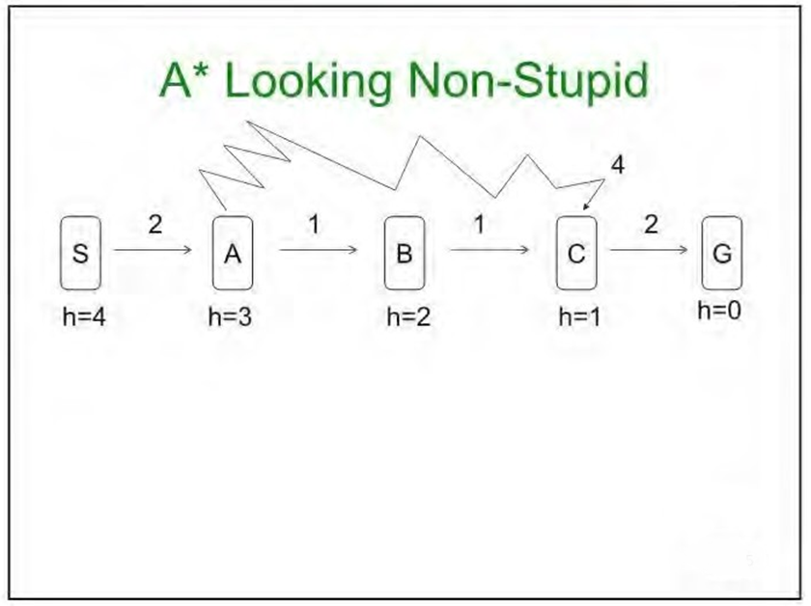
A*
What will A* do here?

Slide 19
A∗ search example
Arad
366 =0=366
Notes:
演示算法-6

Slide 20
A∗ search example
Arad
Sibiu
Timisoara
Zerind
393=140+253
447=118+329
449=75+374

Slide 21
A∗ search example
Arad
Sibiu
Timisoara
Zerind
447=118+329
449=75+374
Arad
Fagaras
Oradea
Rimnicu Vilcea
646=280+366
415=239+176
671=291+380
413=220+193

Slide 22
A∗ search example
Arad
Sibiu
Timisoara
Zerind
447=118+329
449=75+374
Arad
Fagaras
Oradea
Rimnicu Vilcea
646=280+366
415=239+176
671=291+380
Craiova
Pitesti
Sibiu
526=366+160
417=317+100
553=300+253

Slide 23
A∗ search example
Arad
Sibiu
Timisoara
Zerind
447=118+329
449=75+374
Arad
Fagaras
Oradea
Rimnicu Vilcea
646=280+366
671=291+380
Sibiu
Bucharest
Pitesti
Sibiu
591=338+253
450=450+0
526=366+160
417=317+100
553=300+253

Slide 24
A∗ search example
Arad
Sibiu
Timisoara
Zerind
447=118+329
449=75+374
Arad
Fagaras
Oradea
Rimnicu Vilcea
646=280+366
671=291+380
Sibiu
Bucharest
Craiova
Pitesti
Sibiu
591=338+253
450=450+0
526=366+160
553=300+253
Bucharest
418=418+0
615=455+160
607=414+193

Slide 25
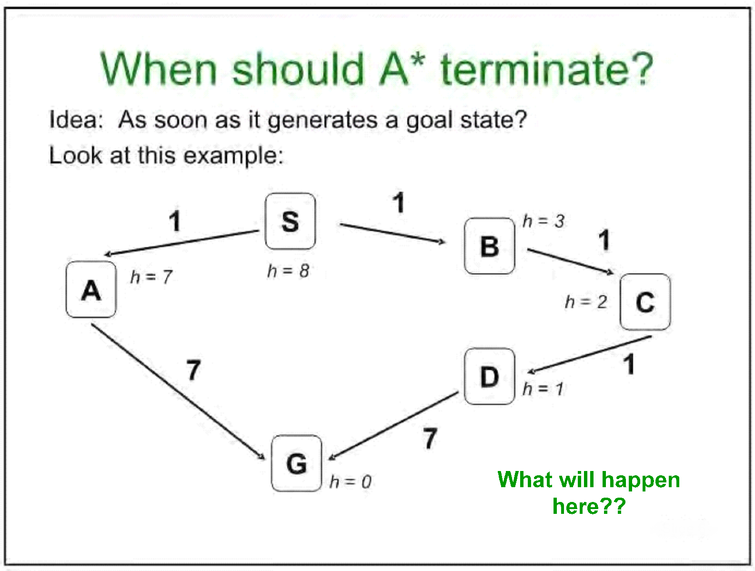

Slide 26
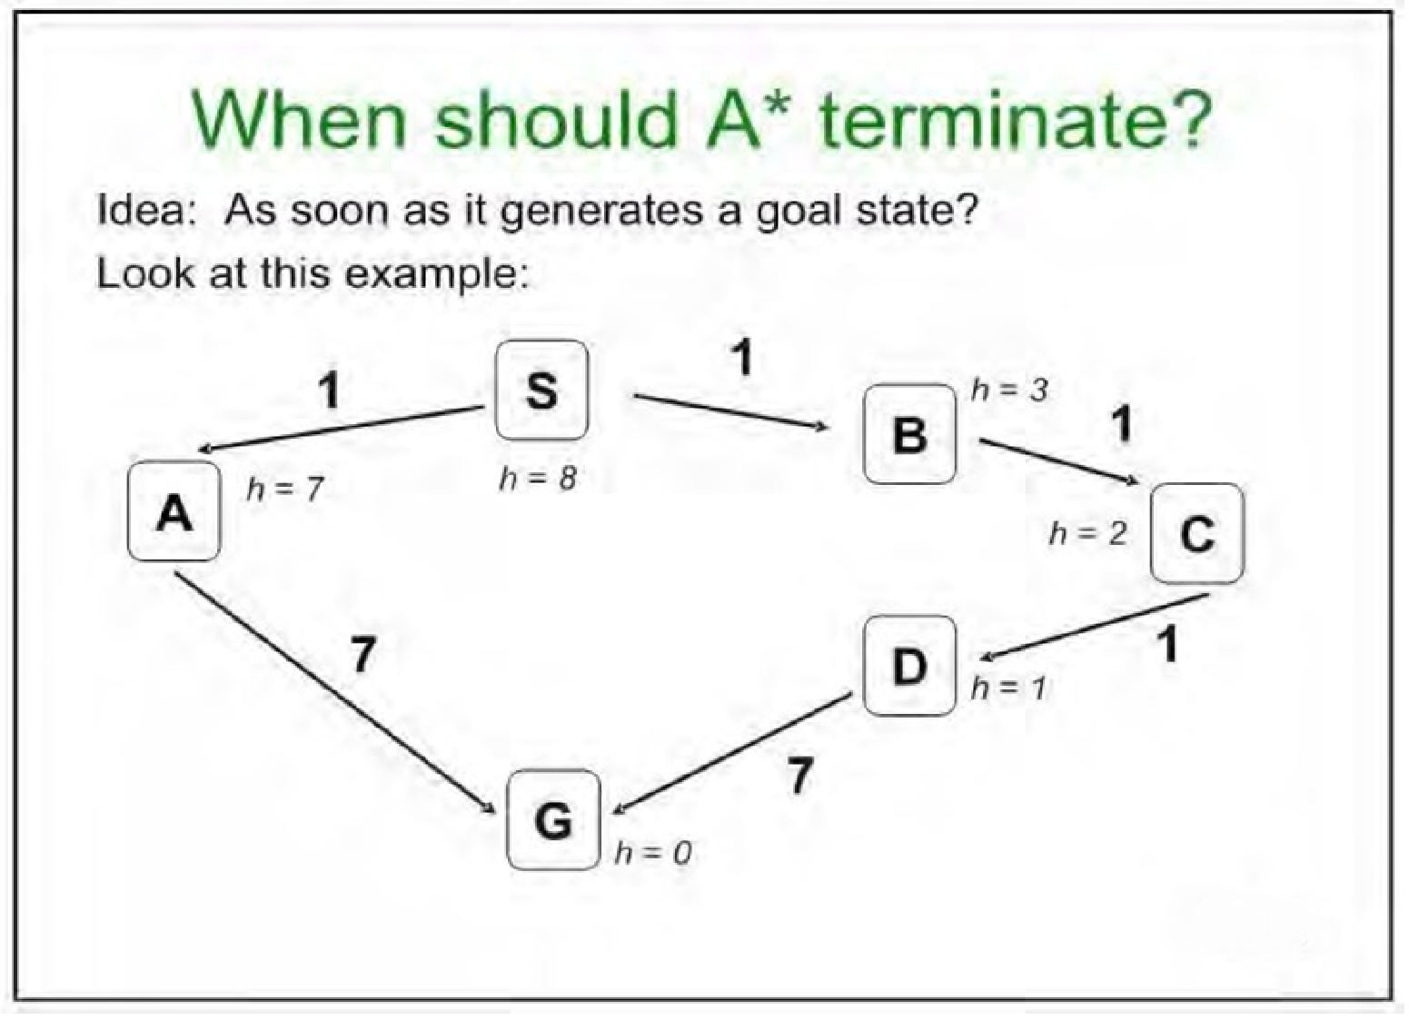
Terminate only after we have REMOVED the
goal from the Frontier.

Slide 27
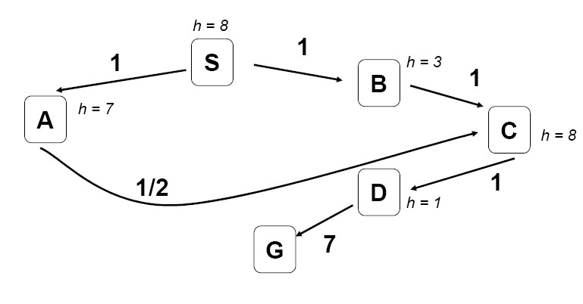
What happens when we visit nodes twice?

Slide 28
What happens when we visit nodes twice?
If A* discovers a lower cost path through a state as it is searching, it should
update the order of that state on the Frontier, based on the lower path cost.

Slide 29

Video of Demo Contours (Empty) – A*

Slide 30
Optimality of A∗ (standard proof)
Suppose some suboptimal goal G₂ has been generated and is in the queue. Let n be an unexpanded node on a shortest path to an optimal goal G₁.
f(G₂) = g(G₂) since h(G₂) = 0
f(G2) > g(G1) since G2 is suboptimal
g(G1) ≥ f(n) since h is admissible, hence, f(G₂) ) > f(n)
Start
n
G
G
2
Since f(G2) > f(n), A* will never select G2 for expansion

Slide 31
Optimality of A∗ ( more useful)
Lemma: A∗ expands nodes in order of increasing f value∗
Gradually adds “f-contours” of nodes (cf. breadth-first adds layers)
Contour i has all nodes with f = f_{i}, where f_{i} < f_{i}+1
O
Z
N
A
I
380
S
F
V
400
T
R
L
P
M
H
U
420
B
D
E
C
G

Slide 32
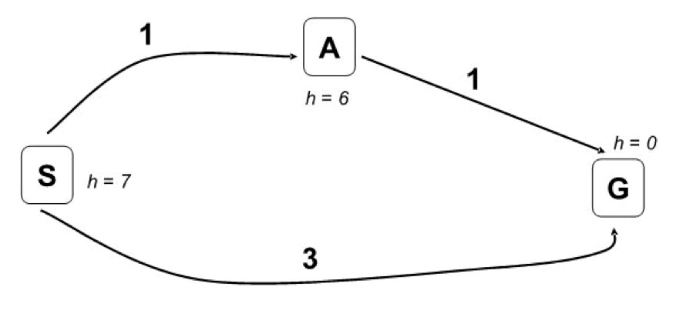
Is A* Guaranteed Optimal?
h = 6
□Try A* search and find what went wrong?
□Estimated goal cost > actual good goal cost
□Estimates should be less than actual costs!

Slide 33
Properties of A∗
Complete?? Yes, unless there are infinitely many nodes with f ≤ f(G)
Time?? Exponential in [relative error in h × length of solution.]
Space?? Keeps all nodes in memory
Optimal?? Yes—cannot expand f_{i}+1 until f_{i} is finished
A∗ expands all nodes with f(n) < C∗ A∗ expands some nodes with:
f(n) = C∗

Slide 34
Proof of Lemma: Consistency
A heuristic is consistent if h(n) ≤ c(n,a,n⁰) + h(n⁰)
If h is consistent, we have
f(n⁰) = g(n⁰) + h(n⁰)
= g(n) + c(n,a,n⁰) + h(n⁰)
≥ g(n) + h(n)
= f(n)
i.e., f(n) is nondecreasing along any path.
n
c(n, a, n⁰)
h(n)
n⁰
h(n⁰)
G
Notes:
c(n,a,n⁰) 从n,到,n⁰的COST

Slide 35
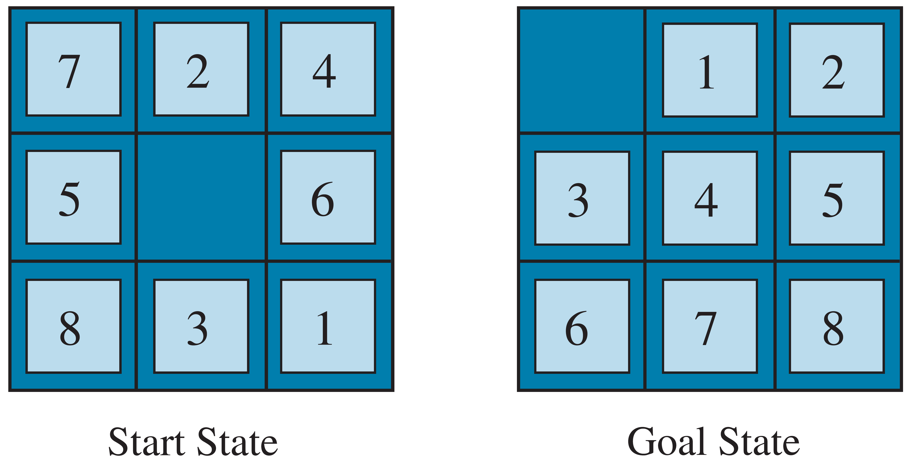
Admissible Heuristics
E.g., for the 8-puzzle:
h₁(n) = number of misplaced tiles
h₂(n) = total Manhattan distance
(i.e., no. of squares from desired location of each tile)
h1(S) =??
h2(S) =??
8
3+1+2+2+2+3+3+2 = 18

Slide 36
Dominance
If h₂(n) ≥ h₁(n) for all n (both admissible) then h₂ dominates h₁ and is better for search Typical search costs:
d = 14 IDS = 3,473,941 nodes
A∗(h₁) = 539 nodes
A∗(h₂) = 113 nodes d = 24 IDS ≈ 54,000,000,000 nodes
A∗(h₁) = 39,135 nodes A∗(h₂) = 1,641 nodes
Given any admissible heuristics h_{a}, h_{b}, h(n) = max(h_{a}(n),h_{b}(n)) is also admissible and dominates h_{a}, h_{b}

Slide 37
Relaxed Problems
Admissible heuristics can be derived from the exact solution cost of a relaxed version of the problem
If the rules of the 8-puzzle are relaxed so that a tile can move anywhere, then h₁(n) gives the shortest solution
If the rules are relaxed so that a tile can move to any adjacent square, then h₂(n) gives the shortest solution
Key point: the optimal solution cost of a relaxed problem is no greater than the optimal solution cost of the real problem

Slide 38
Relaxed Problems contd.
Well-known example: travelling salesperson problem (TSP)
Find the shortest tour visiting all cities exactly once
Minimum spanning tree can be computed in O(n²) and is a lower bound on the shortest (open) tour

Slide 39
Summary
Heuristic functions estimate costs of shortest paths
Good heuristics can dramatically reduce search cost
Greedy best-first search expands lowest h
incomplete and not always optimal
A∗ search expands lowest g + h
complete and optimal
also optimally efficient
Admissible heuristics can be derived from exact solution of relaxed problems

Slide 40
3．对A*算法的评价
A*算法的优点有：
(1)一定能保证找到最优解。
(2)若以搜索的结点数来估计它得效率，则当启发式函数h的值单调上升时，它的效率只会提高，不会降低。
(3)有比较合理的渐近性质。
A*算法的缺点是：
在不仅考虑搜索结点的多少，而且还要考虑搜索结点被搜索的次数的时候，则当h(n)过低估计h*(n)时，有时会显出很高的复杂性。
Notes:
Heuristic leave open possibility that you’ve gone in the wrong direction.
Maybe going to left has a really, really low cost. Wormhole.
How much trade off is a function of the heuristic. If 0, UCS.

Slide 41
Video of Demo Contours (Pacman Small Maze) – A*
Notes:
Same thing, more complex problem.
Search in ”wrong” direction because heuristic wants to go towards goal.
But find the shortest eventually.

Slide 42
以下内容为延伸学习

Slide 43
Weighted A*
Weighted A* defines an evaluation function f(n):
f(n) = g(n) + ε*h(n)
H > 1 introduces a bias towards states that are closer to the goal.
H == 1 generates a provably optimal solution (assuming admissible heuristic).
START
GOAL

Slide 44
Weighted A*
Weighted A* defines an evaluation function f(n):
f(n) = g(n) + ε*h(n)
H > 1 introduces a bias towards states that are closer to the goal.
H == 1 generates a provably optimal solution (assuming admissible heuristic).
Search is typically orders of magnitude faster
Path that is discovered may be sub-optimal (by factorthat depends on ε)

Slide 45
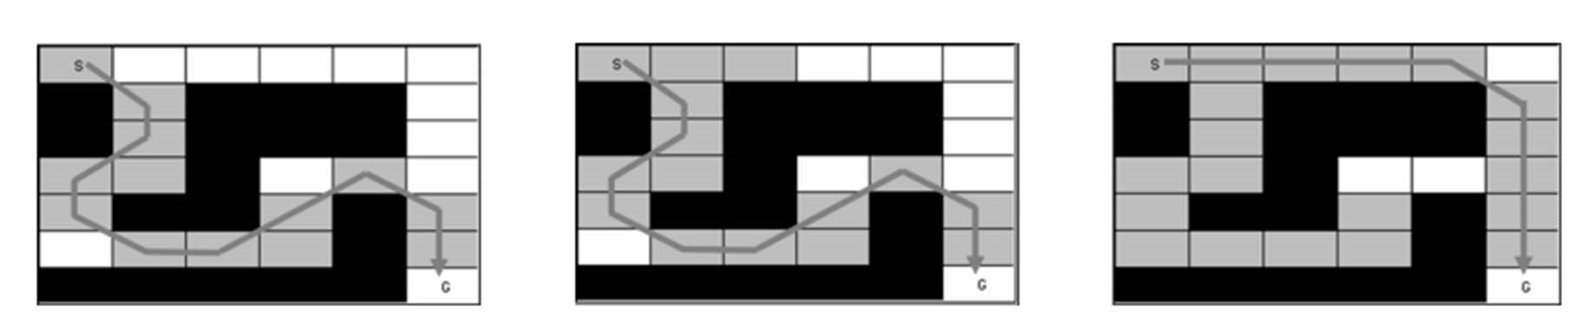
Anytime A*
Weighted A* can be used to construct an anytime algorithm:
Find the best path for a given H
Reduce H and re-plan
H = 2 H = 1.5 H = 1
13 node expansions 15 node expansions 20 node expansions
Solution length: 12 Solution length: 12 Solution length: 10

Slide 46
Heuristic Search (Part 2)
最优搜索-Optimal search
可采纳启发式-Admissible heuristics
迭代加深的A*- IDA*：Iterative Deepening A*
Notes:
可采纳性是指它不会过高估计到达目标的代价。

Slide 47
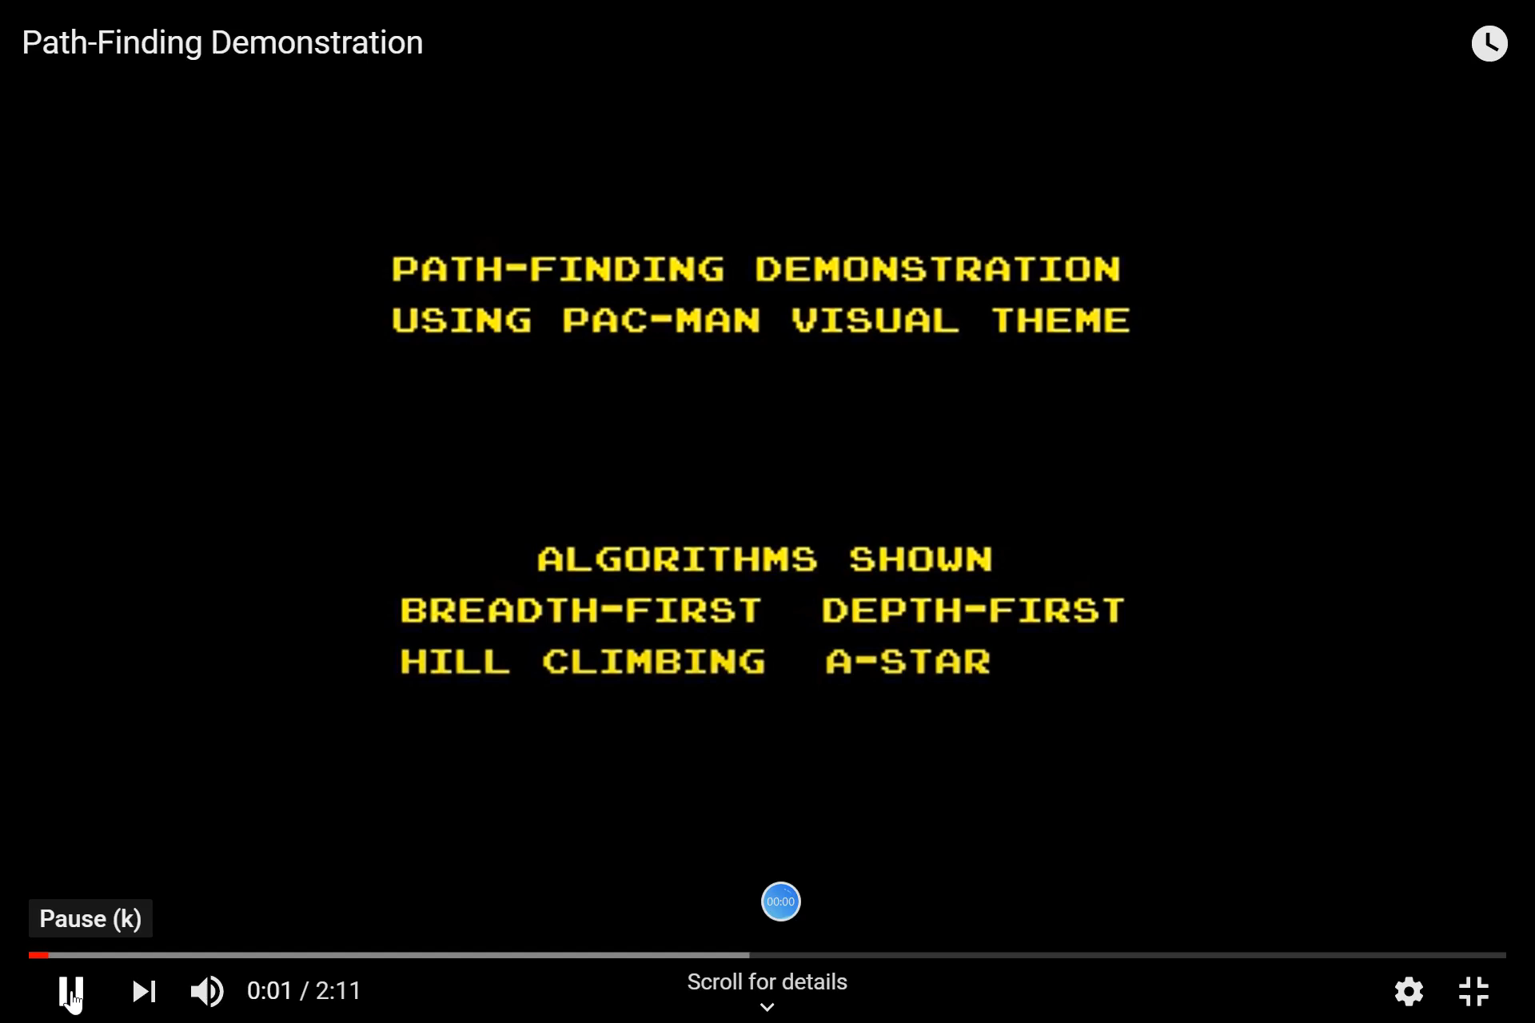
Search animations: Pac Man
Demo video: Pac Man using different algorithms
Notes:
吃豆游戏

Slide 48
Properties of A* depend on conditions on h(n)
To achieve completeness, optimality, and desirably time and space complexity with A* search, we must put some conditions on the heuristic function h(n) and the search space.

Slide 49
Condition on h(n): Admissible
Assume each transition due to an action a has cost ≥ ε > 0.
Let h*(n) be the cost of an optimal path from n to a goal node (f if there is no path). Then an admissible heuristic satisfies the condition: h(n) ≤ h*(n)
an admissible heuristic never over-estimates the cost to reach the goal, i.e., it is optimistic
Hence h(g) = 0, for any goal node g
Also h*(n) = f if there is no path from n to a goal node

Slide 50
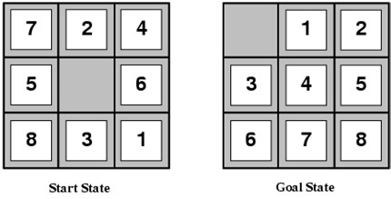
How to build a heuristic?
A useful technique is to simplify a problem when building heuristics, and to let h(n) be the cost of reaching the goal in the easier problem.
For example, in the 8-Puzzle you can only move a tile from square A to B if A is adjacent (left, right, above, below) to B and B is blank
We can relax some of these conditions and:
allow a move from A to B if A is adjacent to B (i.e. we can ignore whether or not position is blank),
allow a move from A to B if B is blank (i.e. we can ignore adjacency),
allow all moves from A to B (ignore both conditions).

Slide 51
How to build a heuristic?
#3 leads to the misplaced tiles heuristic.
To solve the puzzle, we need to move each tile into its final position.
Number of moves = number of misplaced tiles.
Clearly h(n) = number of misplaced tiles ≤ the h*(n) the cost of an optimal sequence of moves from n.
#1 leads to the Manhattan distance heuristic.
To solve the puzzle we need to slide each tile into its final position.
We can move vertically or horizontally.
Number of moves = sum over all of the tiles of the number of vertical and horizontal slides we need to move that tile into place.
Again h(n) = sum of the Manhattan distances ≤ h*(n)
in a real solution we need to move each tile at least that that far and we can only move one tile at a time.

Slide 52
Admissible heuristics make for optimal search Why?
Say we have an optimal path to ngoal with cost g(ngoal). • Let n’goal be a sub-optimal path, meaning g(n’goal) > g(ngoal).
Let n” be any sub-path of the optimal path on the Frontier.
Is it possible for the path to n’_{goal} to be explored before the path to n_{goal}?
No! Because f(n_{goal}) < f(n’_{goal})
Also f(n’’) <= f(n_{goal}), because our heuristic is admissible.
So, f(n’’) < f(n’_{goal})
Meaning sub-paths on the optimal path to n_{goal} will be explored before any sub-optimal path to the goal!

Slide 53
Monotonic, Admissible A*
Complete?
YES. Consider a least cost path to a goal node
SolutionPath = <Start→ n1→ …→ G> with cost c(SolutionPath).
Since each action has a cost ≥ ε > 0, there are only a finite number of paths that have f-value < c(SolutionPath). None of these paths lead to a goal node since SolutionPath is a least cost path to the goal.
So eventually SolutionPath, or some equal cost path to a goal must be expanded.
Time and Space complexity?
When h(n) = 0 for all n, h is monotone (A* becomes uniform-cost search)!
When h(n) > 0 for some n and still admissible, the number of nodes expanded will be no larger than uniform-cost.
Hence the same bounds as uniform-cost apply. (These are worst case bounds). Still exponential complexity unless we have a very good h!
In real world problems, we sometimes run out of time and memory. We will introduce IDA* to address some memory issues, but IDA* isn’t very good when many cycles are present.

Slide 54
Monotonic, Admissible A*
Optimal?
YES. As we saw, the first path to a goal node must be optimal.
Cycle Checking?
We can use a simple implementation of cycle checking (multiple path checking) - just reject all search nodes that visit a state already visited by a previously expanded node. We need keep only the first path to a state, rejecting all subsequent paths.

Slide 55
Limitations of A* Search
Observation: While A * may expandless of the state space, it is still constrained by speed or memory (many states are explored, on Frontier).
Tools to address these problems:
IDA* (Iterative Deepening A*) ‐ similar to Iterative Deepening Search.
Weighted A* ‐ A* with an added weight, to bias exploration toward goal. We looked at this a bit last time!

Slide 56
IDA* ‐ Iterative Deepening A*
Objective: reduce memory requirements for A*
Like iterative deepening, but now the “cutoff” is the f-value (g+h) rather than the depth
At each iteration, the cutoff value is the smallest f-value of any node that exceeded the cutoff on the previous iteration
Avoids overhead associated with keeping a sorted queue of nodes, and the open list occupies only linear space.
Two new parameters:
curBound (any node with a bigger f-value is discarded)
smallestNotExplored (the smallest f-value for discarded nodes in a round); when Frontier becomes empty, the search starts a new round with this bound.
To compute “smallestNotExplored” most readily, expand all nodes with f-value EQUAL to the f-limit.

Slide 57
IDA* Example: 8-Puzzle
f(n) = g(n) + h(n)
h(n) = number of misplaced tiles
blank tile is white
Cutoff=4
1 + 6 = g(n) + h(n) = 7
0
+ 4 = g(n) + h(n) = 4

Slide 58
IDA* Example: 8-Puzzle
f(n) = g(n) + h(n)
h(n) = number of misplaced tiles
blank tile is white
4
Cutoff=4
4
7
7

Slide 59
IDA* Example: 8-Puzzle
f(n) = g(n) + h(n)
h(n) = number of misplaced tiles
blank tile is white
4
Cutoff=4
4
6
7
7

Slide 60
IDA* Example: 8-Puzzle
f(n) = g(n) + h(n)
h(n) = number of misplaced tiles
6
4
Cutoff=4
4
6
7
7

Slide 61
IDA* Example: 8-Puzzle
f(n) = g(n) + h(n)
h(n) = number of misplaced tiles
7
6
4
Cutoff=4
4
6
7
7

Slide 62
IDA* Example: 8-Puzzle
f(n) = g(n) + h(n)
h(n) = number of misplaced tiles
blank tile is white
Cutoff=6
4
7
Notes:
演示算法-7

Slide 63
IDA* Example: 8-Puzzle
f(n) = g(n) + h(n)
h(n) = number of misplaced tiles
blank tile is white
4
Cutoff=6
4
7
7

Slide 64
IDA* Example: 8-Puzzle
f(n) = g(n) + h(n)
h(n) = number of misplaced tiles
blank tile is white
4
Cutoff=6
4
6
8
7
7

Slide 65
IDA* Example: 8-Puzzle
f(n) = g(n) + h(n)
h(n) = number of misplaced tiles
blank tile is white
4
Cutoff=6
4
6
8
7
7

Slide 66
IDA* Example: 8-Puzzle
f(n) = g(n) + h(n)
h(n) = number of misplaced tiles
blank tile is white
6
4
Cutoff=6
4
6
8
7
7

Slide 67
IDA* Example: 8-Puzzle
f(n) = g(n) + h(n)
h(n) = number of misplaced tiles
blank tile is white
6
6
4
Cutoff=6
4
6
8
7
7

Slide 68
IDA* Example: 8-Puzzle
f(n) = g(n) + h(n)
h(n) = number of misplaced tiles
blank tile is white
6
6
4
Cutoff=6
4
6
8
7
7

Slide 69
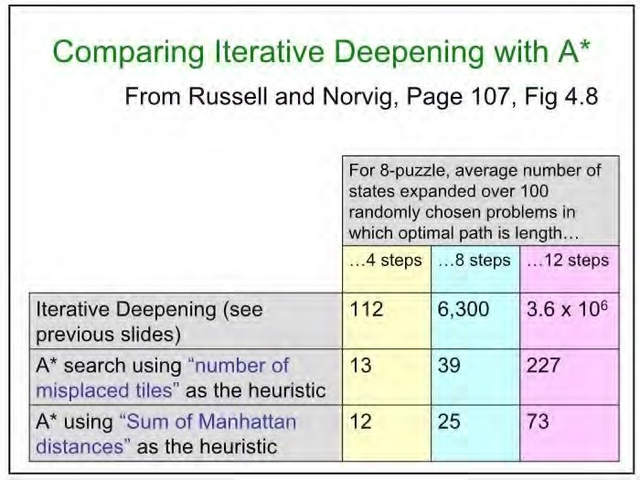

Slide 70
参考文献信息
本课件部分内容的编写参考了如下学者的教材和课件，在此感谢原著者。
朱福喜，
Stuart J. Russell,
Sheila McIlraith
Faheim Bacchus
Andrew Moore
Hojjat Ghaderi
Craig Boutillier
Jurgen Strum
Shaul Markovitch

